Slide 1
WP 3: Core Framework Implementation
T3.4: Hyperty Services Framework
Alice Cheambe (Fraunhofer FOKUS)
Berlin 2015

Slide 2
Agenda
Overview
Objectives
Work Plan
Methodology

Slide 3
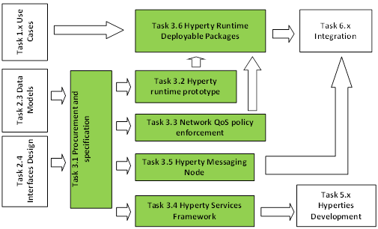
Overview I
Objectives
Develop JavaScript Framework libraries to facilitate the development of Hyperties.
Modular in nature to support different Hyperty types (RTC Uas, Content Player/producer, IoT Sensor/actuator GW, Connectors, etc.)
Deliverables
Key facts
Hyperty Runtime and Hyperty Messaging Node Phase 1.
This deliverable will contain the source code and all associated documentation generated in the phase 1 of T3.4
Duration: 18 months
Start: June 2015
Partners:
DTAG, PTIN, Fraunhofer (lead), Apizee, QUOBIS

Slide 4
Overview II
Dependency:
Task 3.2: enhance WebRuntime engine with protocol on the fly and codec on the fly, identity management, enhanced Messaging API, enhanced Application Lifecycle management
Task 3.3: demonstrate & benchmark “in-network” and “over-the-network” approaches to enforce QoS.
Task 5.2: Hyperties Implementation

Slide 5
Objectives
Code organization
Small files + objects, each with a defined role
Well defined Hyperty template
Common API to instantiate and plug-in Hyperty
Adaptability + extensibility
Any piece of the module can be switched out without affecting the rest of the services

Slide 6
Workplan Phase
Time Frame: June 2015 (M6)- December 2016 (M24)
Choose / specify, design and implement modular framework architecture
Identify and specify Core Service APIs
Hyperty Service Framework
Implement Core Service APIs
Usage examples snippet
Documentation
Work plan Phase 1
Work plan Phase 2

Slide 7
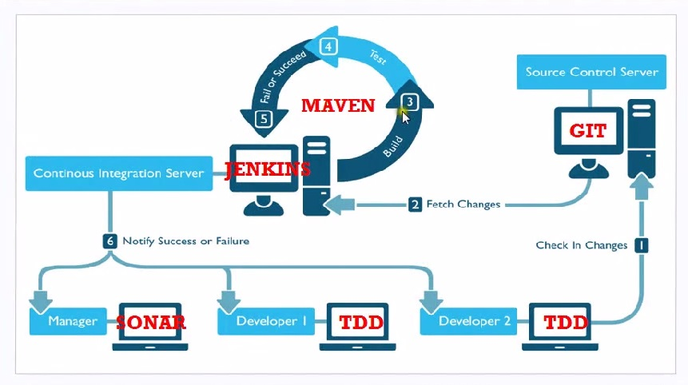
Methodology
Test Driven Development
Qunit, Karma, Buster.js, Jasmine ,etc.
GitHub for Source code version control
Maven
project versioning, automated testing; continuous integration; dependency management; packaging; and release management
Nexus Repository Server
Centralized hosted libraries for sharing amongst partners
Jenkins
Continuous integration server
Sonar
Generate statistics and test coverage
Notes:
Continuous Integration approach

Slide 9
erster Punkt
Textbeispiel
zweiter Punkt
Textbeispiel
erster Punkt
zweiter Punkt
dritter Punkt
dritter Punkt
vierter Punkt
Textbeispiel
Textbeispiel
fünfter Punkt
erster Punkt
zweiter Punkt
dritter Punkt
vierter Punkt
erster Punkt
zweiter Punkt
dritter Punkt
vierter Punkt

